Slide 1
React Fundamentals Crash Course Episode 01

Slide 2

Contents To Watch Out For
Before We Begin
Updating To React 18
What’s React?
What Is A Component?
Why Learn React?
Function Components
Setup
Creating A New Component
Creating A New React App
Understanding Files And Folders

Slide 3
Contents To Watch Out For
Default And Named Exports
Conditional Rendering
JSX
List Rendering
States And Props
Styling
Hooks At A Glance
Forms
Event Handling
HTTP GET And POST Requests
Parent Child Communication
Use Transition Hook

Slide 4
Before We Begin
</> | This course is for complete beginners
</> | HTML, CSS and modern JavaScript are prerequisites
</> | Focus is on React concepts for a beginner
</> | React 18 will be used

Slide 5
What’s React?
</> | React is an open-source JavaScript library for building user interfaces
</> | React has a rich eco system and plays well with other libraries and is more than capable of building enterprise scale web applications

Slide 6
Why React?
Now that we know what React is, the next question is: Why React?
</> | The answer lies in Reacts ability to simplify and streamline the process of building robust and interactive user interfaces.
</> | Reacts declarative syntax, efficient rendering through the Virtual DOM, reuseable components, unidirectional data flow and a strong ecosystem of libraries make it an ideal choice for developers aiming to create scalable and maintainable web applications.
</> | Today, we'll explore the key reasons why React has become a go-to framework for modern web development.

Slide 7
Features of React
As we embark on our journey with React, it's essential to understand the features that set it apart.
</> | React comes equipped with a rich set of tools and capabilities that contribute to its success.
</> | From the component-based architecture to the Virtual DOM, JSX syntax, and state management, Reacts features empower developers to create complex UIs with ease.

Slide 8
How Industries’ See React?
In the fast-evolving landscape of web development, keeping an eye on industry trends is crucial.
</> | React has not only established itself as a leading library when compared to angular and vue but has also influenced broader trends in front-end development.
</> | From the rise of component-based architectures to the adoption of virtualization techniques, React has left a significant mark on how developers approach building user interfaces.
</> | Today, React is being used by a lot of big companies and startups like Facebook, Instagram, Netflix, Dropbox, The New York Times, Khan Academy, Reddit and many more!

Slide 9
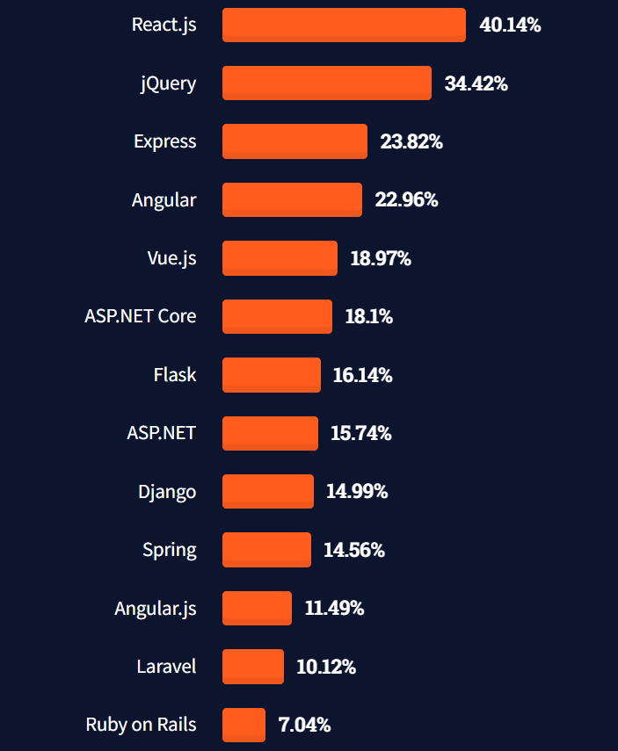
How Industries See React?
This year, React.js surpassed jQuery as the most used web framework.
Source: https://insights.stackoverflow.com/survey/2021#most-popular-technologies-webframe

Slide 10
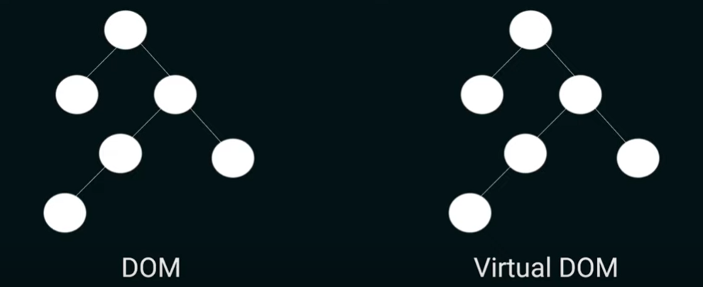
DOM Manipulation & Virtual DOM

Slide 11
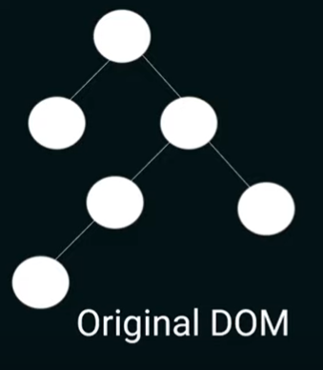
DOM Manipulation & Virtual DOM

Slide 12
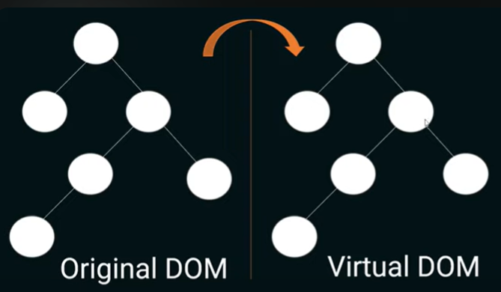
DOM Manipulation & Virtual DOM

Slide 13
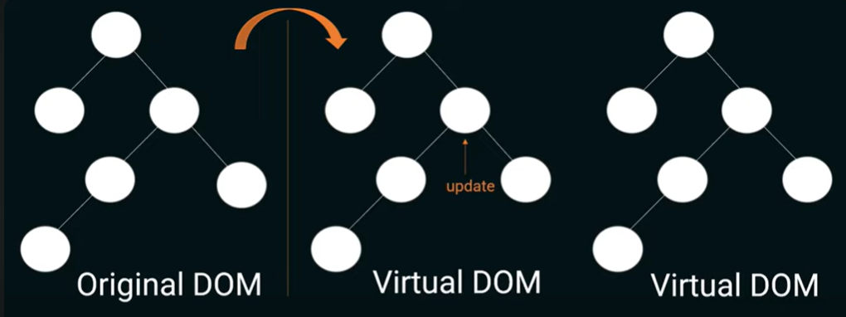
DOM Manipulation & Virtual DOM

Slide 14
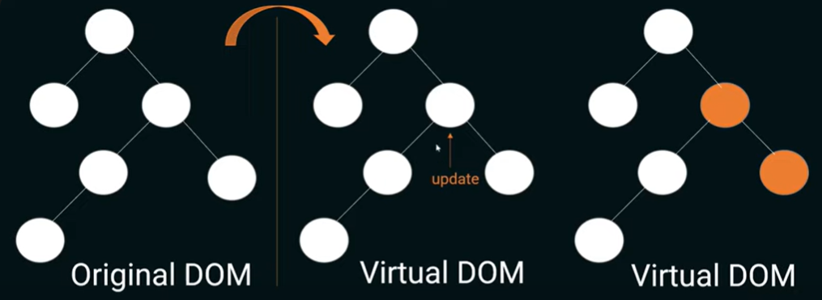
DOM Manipulation & Virtual DOM

Slide 15
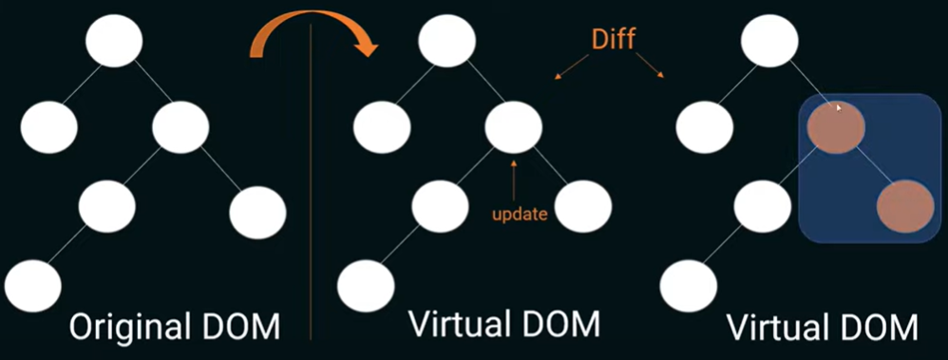
DOM Manipulation & Virtual DOM

Slide 16
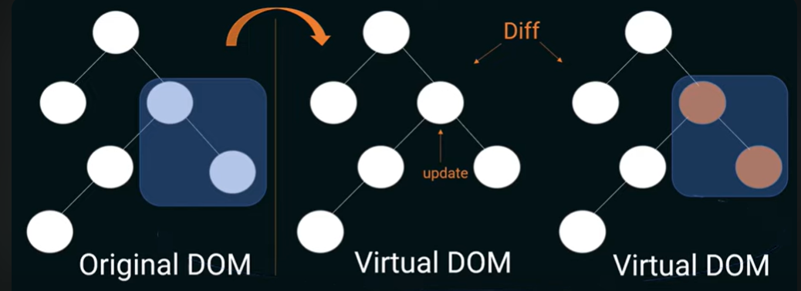
DOM Manipulation & Virtual DOM

Slide 17
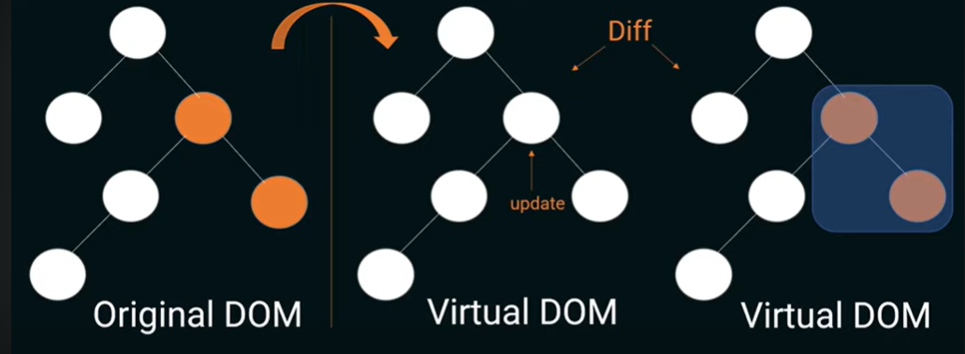
DOM Manipulation & Virtual DOM

Slide 18
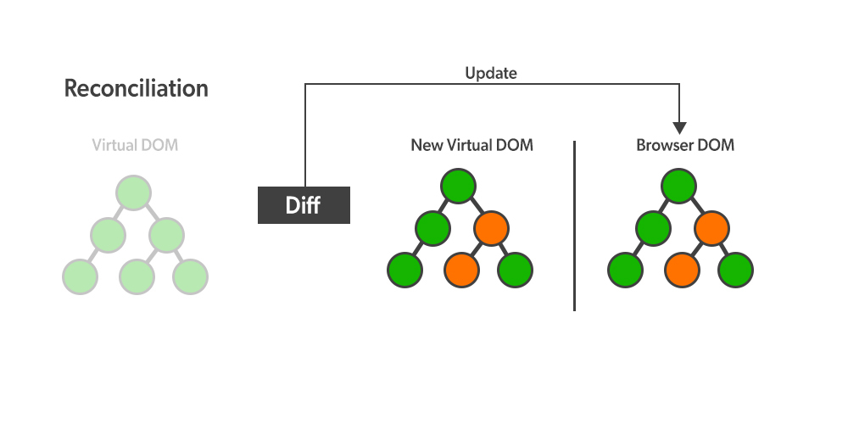
DOM Manipulation & Virtual DOM
Reconciliation: React keeps the in-memory Virtual representation of the actual DOM and keeps it in sync with a batch update.
Diffing: Diffing Algorithm in React JS differentiates the updated and previous DOM of the application.

Slide 19
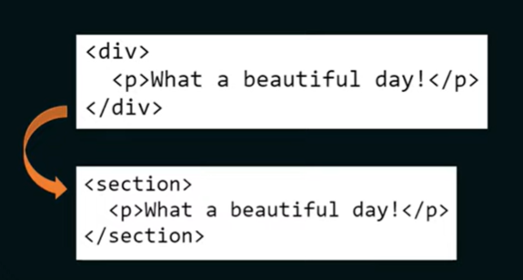
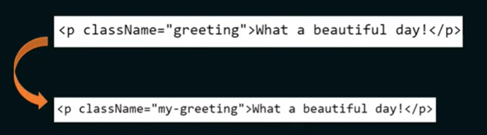
DOM Manipulation & Virtual DOM

Slide 20
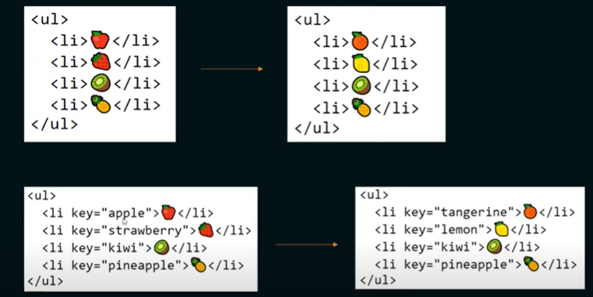
DOM Manipulation & Virtual DOM

Slide 21
Virtual DOM Vs. Real DOM
Comparison | Virtual DOM | Real DOM
State Management | Integrated with reacts state management. | Manual state management.
Rendering Efficiency | Renders only changed elements. | Renders entire UI on change.
Browser Manipulation | Operates independently, minimizing direct browser manipulation. | Direct interaction with the browser’s DOM, causing frequent reflows and repaints.
Change Handling | Automatic change handling through a reconciliation algo. | Manual handling of changes.
Performance Impact | Less resource-intensive, optimizing updates. | Resource-intensive due to constant rendering.

Slide 22
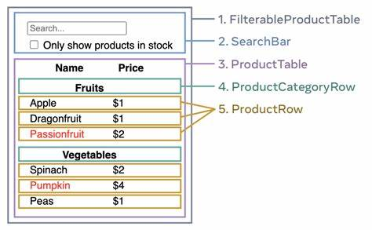
Thinking in React
React can change how you think about the designs you look at and the apps you build.
</> | When you build a user interface with React, you will first break it apart into pieces called components.
</> | Then, you will describe the different visual states for each of your components.
</> | Finally, you will connect your components together so that the data flows through them.

Slide 23
React Data Binding
Understanding React One-Way Data Binding
</> | Definition: Reacts one-way data binding is a unidirectional flow of data from the parent component to its child components.
</> | How it Works: Data flows from the parent component to child components through props. Child components receive data but cannot directly modify it.
</> | Advantages: Predictable data flow. Easier to trace and debug.

Slide 24
React Data Binding
Exploring React Two-Way Data Binding
</> | Definition: Reacts two-way data binding allows data to flow bidirectionally, both from parent to child and vice versa.
</> | How it Works: Parent components pass data to children using props. Child components can also send data back to parents through events or callbacks.
</> | Use Case: Ideal for interactive user interfaces where data changes in real-time.

Slide 25
React Data Binding
Comparing One-Way and Two-Way Data Binding
One-Way Data Binding | Two-Way Data Binding
Data flows unidirectionally (parent to child). | Data flows bidirectionally (parent to child and vice versa).
Components are loosely coupled. | Components are more tightly coupled.
Reduced risk of unexpected side effects. | Convenient for forms and real-time updates.

Slide 26
React Data Binding
Making the Choice
</> | Choosing the Right Approach: Consider the project requirements and complexity. One-way for simplicity, predictability; Two-way for real-time updates and interactivity.
</> | Final Thoughts: React provides both options to cater to different scenarios. Understanding the context helps in making an informed decision.

Slide 27
Ask Me Anything - Your Queries, Our Answers No question is too big or too small. Feel free to ask about React, web development, or anything else you're curious about.

Slide 28
Thank You! Presented By: Mayur Pai

